Slide 1

The Hybrid Azure Story
Sarah Lean
Senior Cloud Advocate
Microsoft
@Techielass
www.techielass.com

Slide 2



Who am I?
Cloud Advocate @ Microsoft
Blog at www.techielass.com
@Techielass
Founder of the Glasgow Azure User Group
STEM Ambassador
14+ years in the IT industry
IT Pro

Slide 3
Software and hardware refresh
Security threats
Urgent capacity needs
Compliance
Quickly integrate acquisitions
Application innovation
Migration drivers
Software end of support
Datacenter contracts expiry

Slide 4


Slide 5

THE WEBSITE

Slide 6

Traffic Manager
Traffic Manager
DNS-based load balancer
Supports external, non-Azure endpoints
Hybrid cloud and on-premises deployments
Public facing endpoint
Routing methods
Priority, weighted, performance, geography, subnet, multi-value
Microsoft Azure | @Techielass

Slide 7
How does it work
www.tailwindtraders.com
CNAME
tailwind.trafficmanager.net
Load-balancing and
Endpoint monitoring
Cloud service
Azure web site
Non-Azure
Endpoints
Microsoft Azure | @Techielass

Slide 8


External Endpoints
Traffic Manager supports endpoints outside of Azure
Simply specify an arbitrary DNS name, e.g. mysite.tailwindtraders.com
Works with all traffic-routing methods
Enables a variety of ‘hybrid’ scenarios
Smooth migration from on-premises to Cloud
Geo-expansion of existing applications
Burst-to-Cloud
Failover-to-Cloud
Traffic Manager
Azure Endpoint
On-Premises Endpoint
Microsoft Azure | @Techielass

Slide 9

Server Management

Slide 10

Windows Admin Center: Your bridge to the cloud
Discover Azure services that bring value to your environment
Automatically set up in a few clicks
Seamlessly transition to the Azure portal

Slide 11
Server management reimagined
Manage systems, including multiple versions of Windows Server
Bolster network security
Keep local files in sync with the cloud
Apply updates
Streamline everyday tasks on premises
Add hybrid capabilities
Monitor server performance
Back up servers
Protect servers intelligently
Predict capacity needs
Resolve server issues
Maximize performance, availability
Microsoft Azure | @Techielass

Slide 12














Extend on-premises into Azure
Centrally manage from Azure
Business continuity & disaster recovery
Secure
Monitor
Update
Azure Site Recovery
Azure Backup
Storage Replica
Azure Security Center
Azure Monitor
Azure Update Management
Extend on-premises capacity
Storage
Azure File Sync
Storage Migration Service
Compute
Cloud Witness
Create Azure VM
Azure Arc for Servers
Azure Policy
Networking
Azure Network Adapter
Azure Extend Network
Microsoft Azure | @Techielass

Slide 13









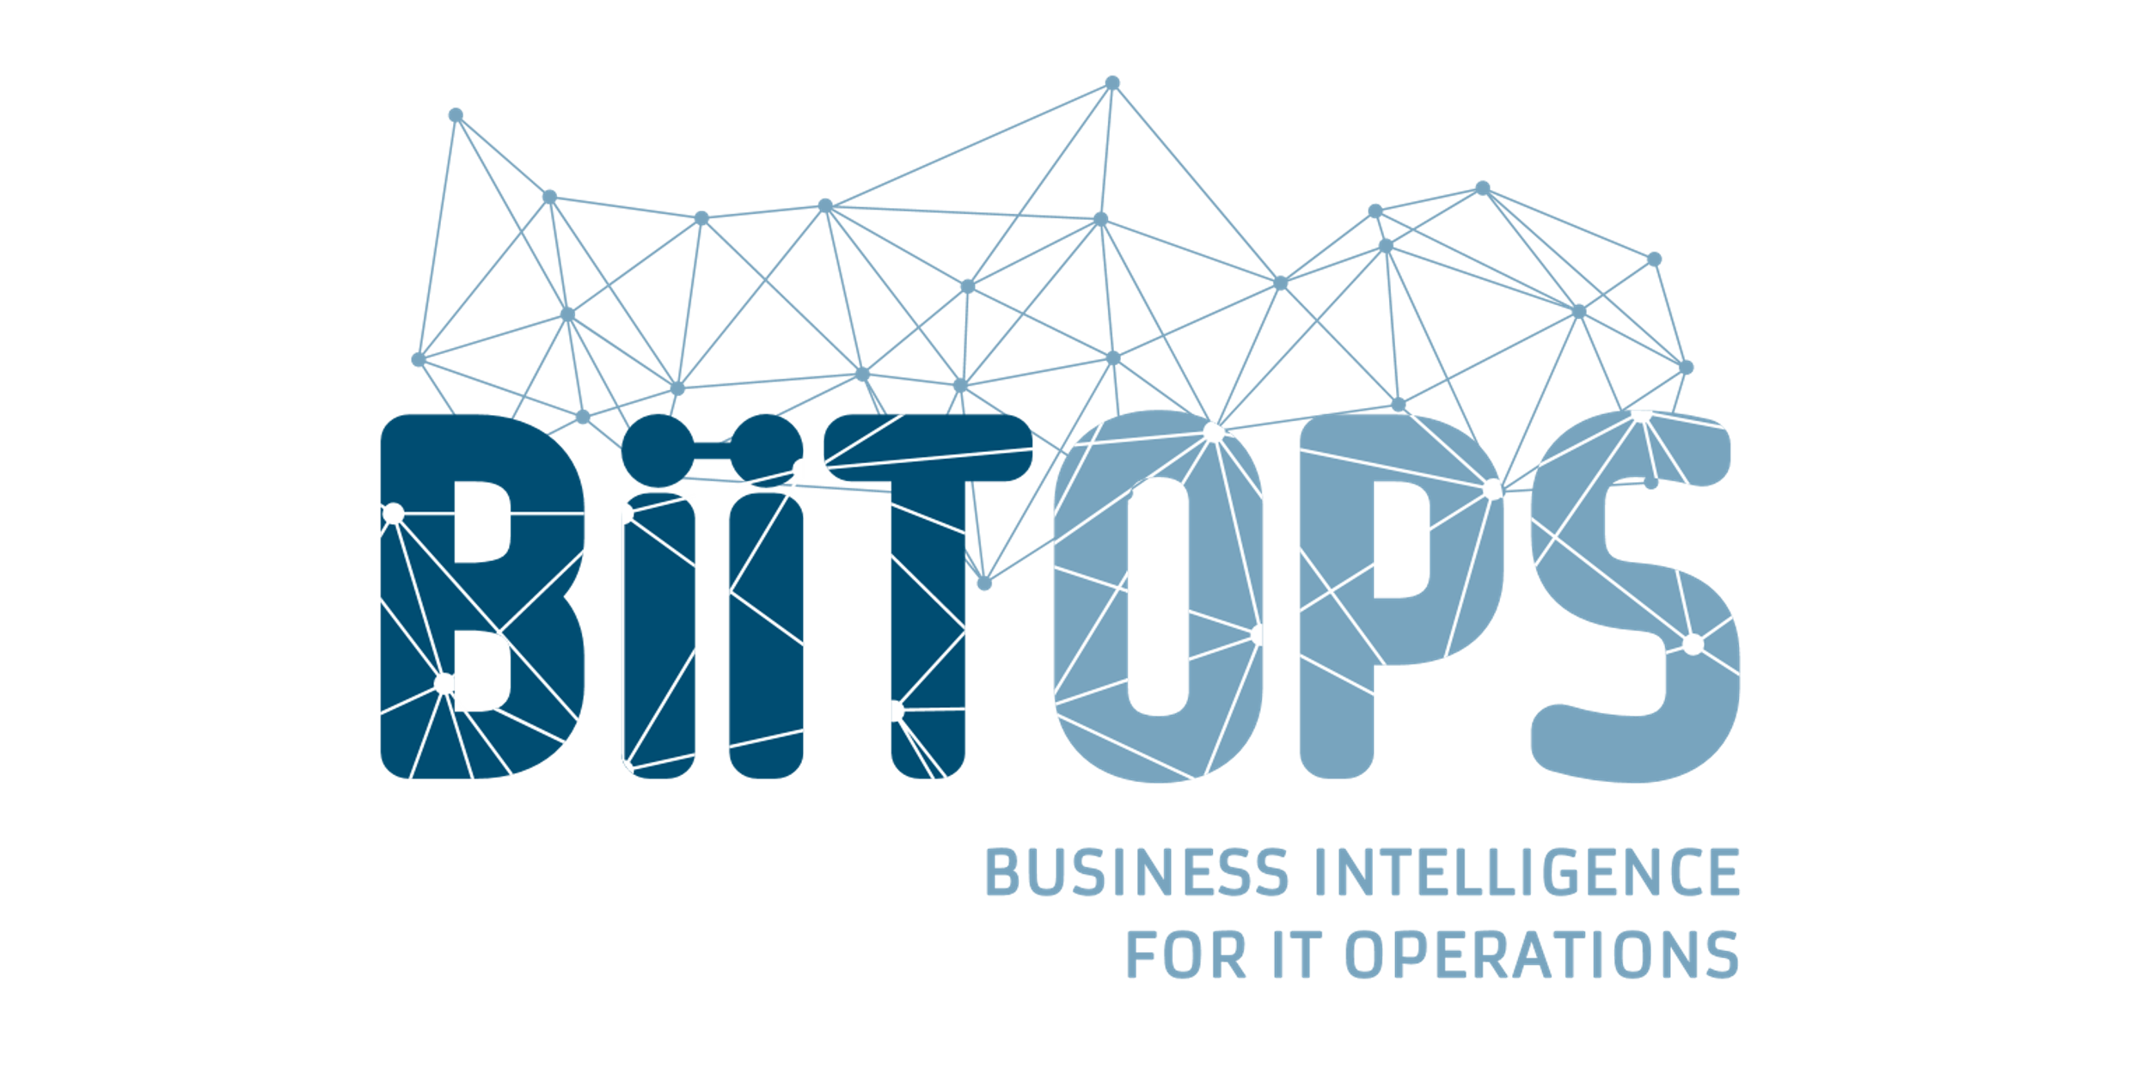

Windows Admin Center Partners
Microsoft Azure | @Techielass

Slide 14

Compliance & Consistency

Slide 15

Azure Arc
Bring Azure services and management to any infrastructure
Run Azure Data Services anywhere
Extend Azure management across your environments
Adopt cloud practices on-premises
Implement Azure security anywhere
Azure Arc is a set of technologies that extends Azure management and enables Azure services to run across on-premises, multi-cloud, and edge

Slide 16




Azure Arc enabled servers Bring on-premises and multi-cloud servers to Azure with Azure Arc
Reach
Organize and Inventory
Governance and Security
Role-Based Operations
Linux and Windows
VM and Bare-Metal
Domain agnostic
At scale searchable inventory
Unify management experience
Consistent VM extensions
Integrate with Azure Lighthouse
Built-in Azure policies
Server security baselines
Compliance across environments
Centralized agent management – Monitoring, Security, Update Management
Central IT to manage at-scale operations
Workload owners manage based on their access
Any infrastructure, familiar tools

Slide 17
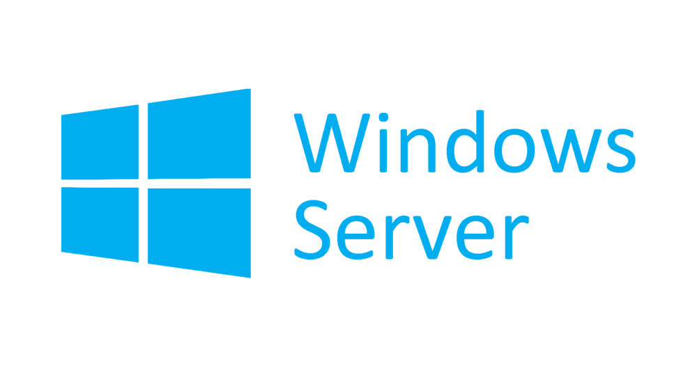




Azure Arc enabled servers Azure Arc enabled servers are auto-enrolled with additional Azure services
Additional services
Azure Policy
Azure Defender
Azure Sentinel
Azure Monitor
Change and inventory tracking
Update management
Azure Security Center
AWS Linux 2
Just turn them on when you want to use them

Slide 18

Backups

Slide 19



Architecture matters
Architecture matters
Scale-up Within the enterprise
Azure Backup Service
Data plane
No infrastructure
Backup extension
Recovery Point Management
Data Pruning
Enterprise scale
Storage Management
Data Packing
Extensible
Backup extension
Authentication
Policy Management
Monitoring
&
Reporting
Central management
Access Control
Management plane
Microsoft Azure | @Techielass
Microsoft Azure | @Techielass

Slide 20
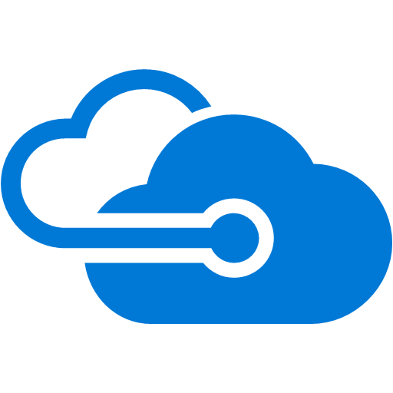
Restore-as-a-Service
Restore-as-a-Service
No infrastructure
Azure Backup Service
Inspect before restore
Recovery
Services Management
iSCSI connection
Consistent
iSCSI Target
iSCSI Initiator
Azure VM
Data plane
.VHD
snapshots
iSCSI Target
iSCSI Connection
iSCSI Initiator
.VHD
snapshots
On-premises server
Azure Backup Agent
Microsoft Azure | @Techielass

Slide 21
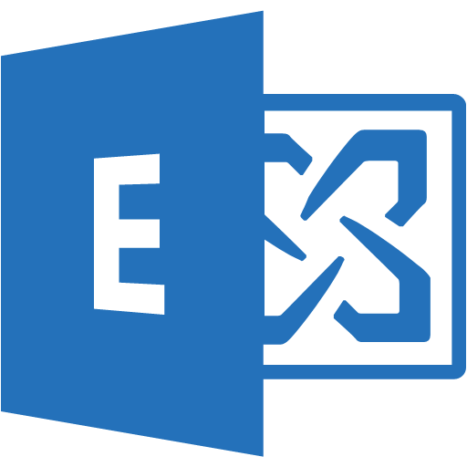
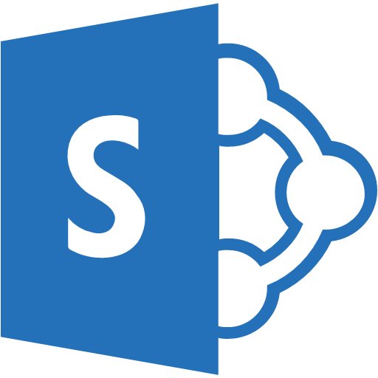

Hybrid deployment models
Hybrid Deployment Models
Azure Backup Server or DPM
Direct-to-Azure
Azure Backup agent (MARS)
SQL Server
Exchange
SharePoint
File Server
Microsoft
Active Directory RODC
Physical
Hyper-V
VMware
File Server
Main datacenter
Branch offices
Microsoft Azure | @Techielass

Slide 22
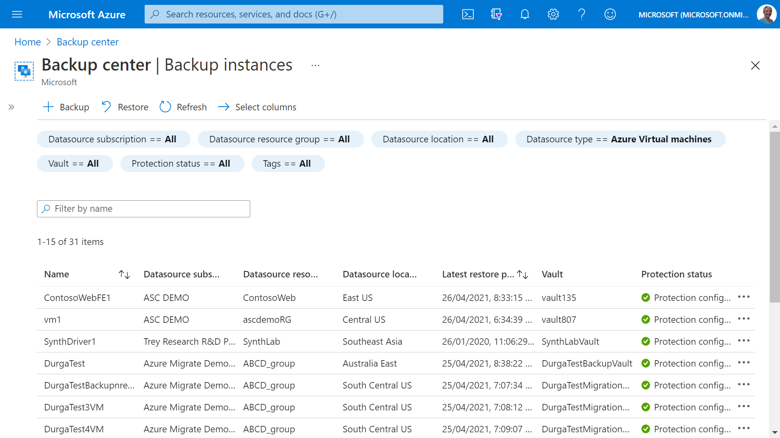
Hybrid deployment models
Azure Backup Center
Single pane of glass
Connected experience
Microsoft Azure | @Techielass

Slide 23

Keeping up to date

Slide 24
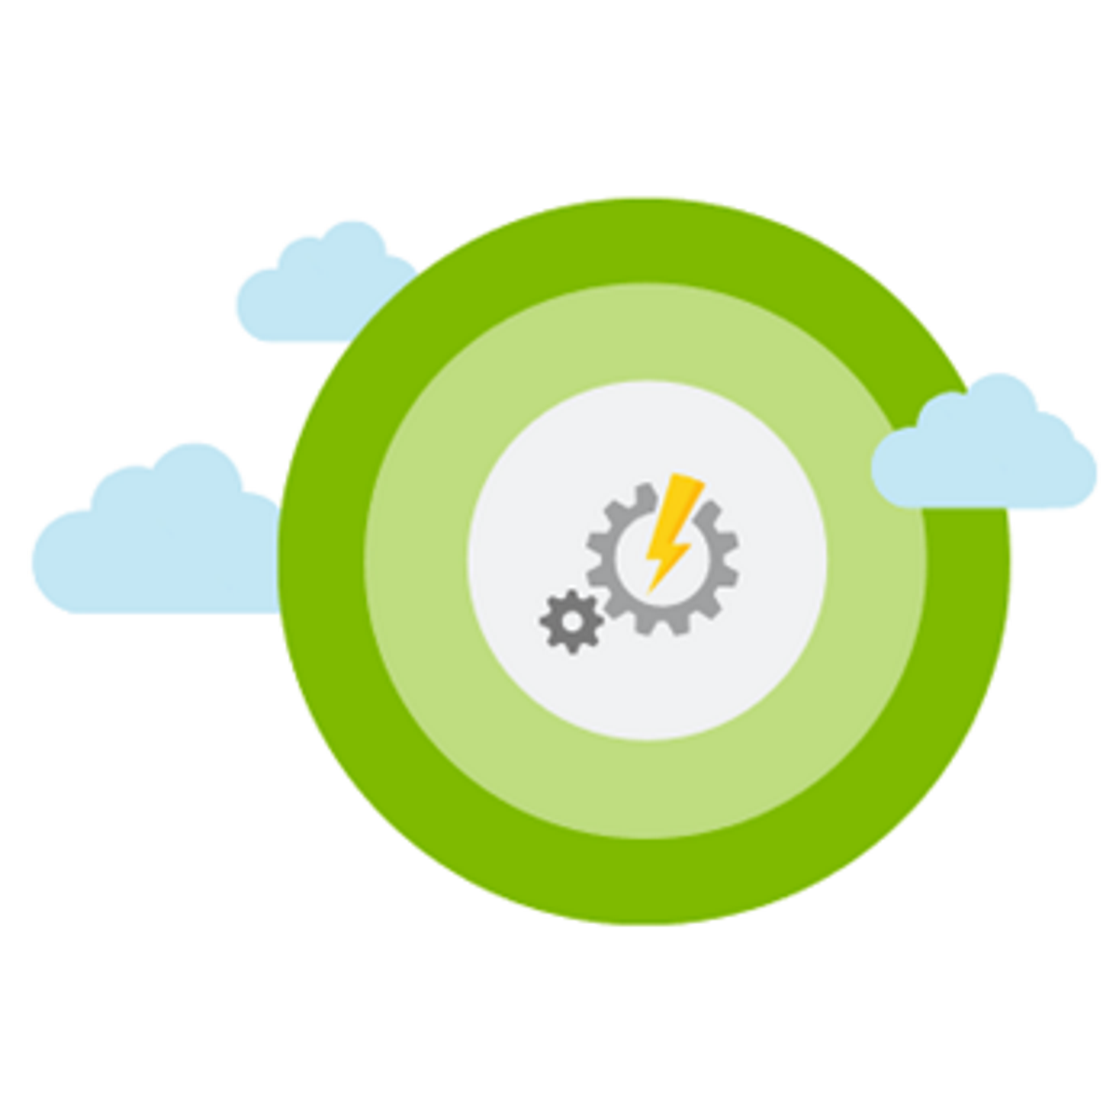
Azure Update Management
Assess update status of servers across your environment
Windows, Linux
Azure, other cloud, on-prem Deploy updates
Custom approval criteria
Single pane of glass
Automated periodic deployments
Verify Compliance
Assess Updates
Deploy Updates

Slide 25
Security

Slide 26







Threat actors leverage a variety of exposures to breach
Exposure
Access
Lateral movements
Actions
Insecure
configuration
Virtual machines
Virtual machines
Data loss
Vulnerabilities
Apps
Apps
Data exfiltration
Infected admin
Credentials
Credentials
Ransomware
Open entry points
Data stores
Data stores
Resource abuse
Exposed credentials
IoT devices
IoT devices
Compromised user
Microsoft Azure | @Techielass

Slide 27



Azure Security Center
Strengthen security posture
Protect against threats
Cloud security posture management
Secure Score | Policies and compliance
For servers
For cloud native workloads
For databases and storage
Get secure faster
Microsoft Azure | @Techielass

Slide 28





Security posture management with Secure Score
Evaluated Categories
Gain instant insight into the security state of your cloud workloads
Address security vulnerabilities with prioritized recommendations
Improve your Secure Score and overall security posture in minutes
Speed up regulatory compliance
Access
Compute
SQL server
Network
App
+7%
+2%
+1%
+3%
+2%
Secure Score Impact
50%
Secure Score
Microsoft Azure | @Techielass

Slide 29


Protect your workloads from threats Use industry’s most extensive threat intelligence to gain deep insights
Detect & block advanced malware and threats for Linux and Windows Servers on any cloud
Protect cloud-native services from threats
Protect data services against malicious attacks
Protect your Azure IoT solutions with near real time monitoring
Azure Security Center
Apps
VMs/
Servers
Containers
SQL
IoT
Network
Management
Cloud workload protection
Microsoft Azure | @Techielass

Slide 30

Thank you! Resources: https://aka.ms/azure-hybrid-story
Sarah Lean
Senior Cloud Advocate
@Techielass
www.techielass.com
Microsoft Azure | @Techielass

